Slide 1
Oak Ridge Airport
Project Update
Presented to
Oak Ridge City Council
Metropolitan Knoxville Airport Authority
Oak Ridge, Tennessee
September 2013

Slide 2
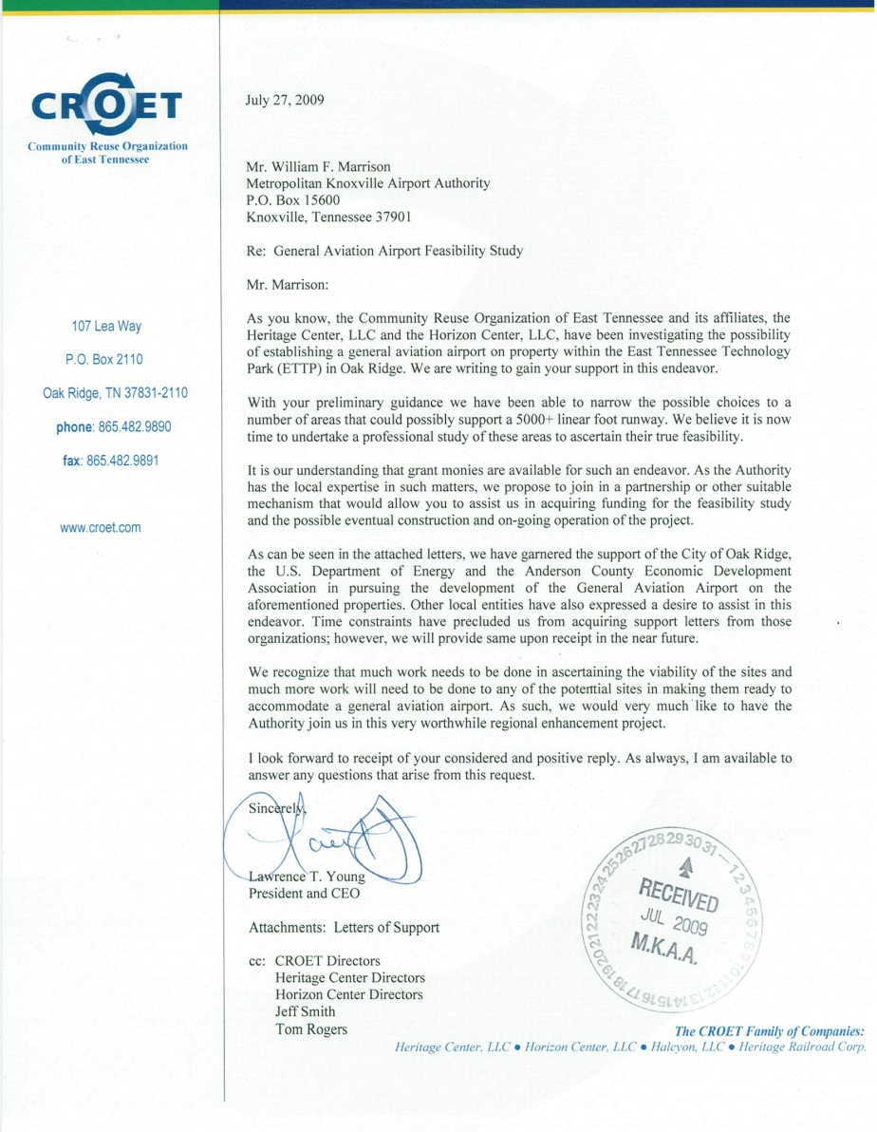
Project origin:
2009 letter from CROET to Metropolitan Knoxville
Airport Authority (MKAA)
Notes:
Picture of K-25 Site. Speak about reindustrialization of site. How we got started.

Slide 3

The Oak Ridge project is consistent with MKAA’s mission and mandate
Our Mission | Our Legislative Mandate
Provide high-quality facilities and services to meet regional aviation-related needs Support development of East Tennessee | Operate airports “for a public purpose and public necessity” (T.C.A. § 42-4-102)

Slide 4
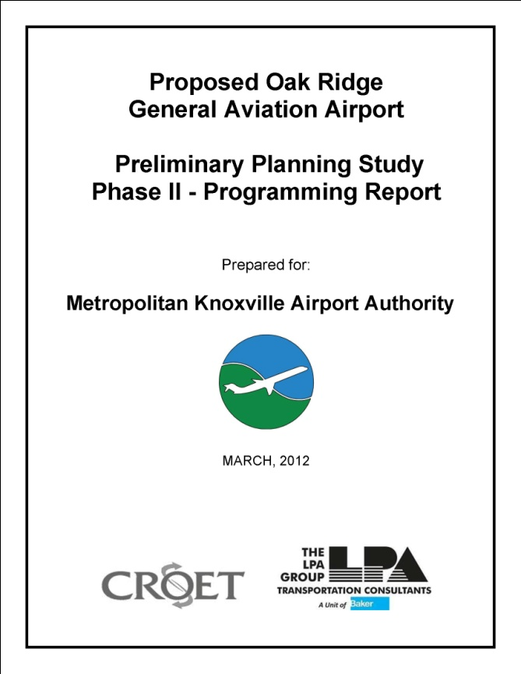
MKAA conducted a 3-part study to determine the airport’s viability
Preliminary planning study:
Identified potential sites
Programming report:
Evaluated design and costs
Justification study:
Defined use and economic benefits
2010
2011
2012
2013

Slide 5
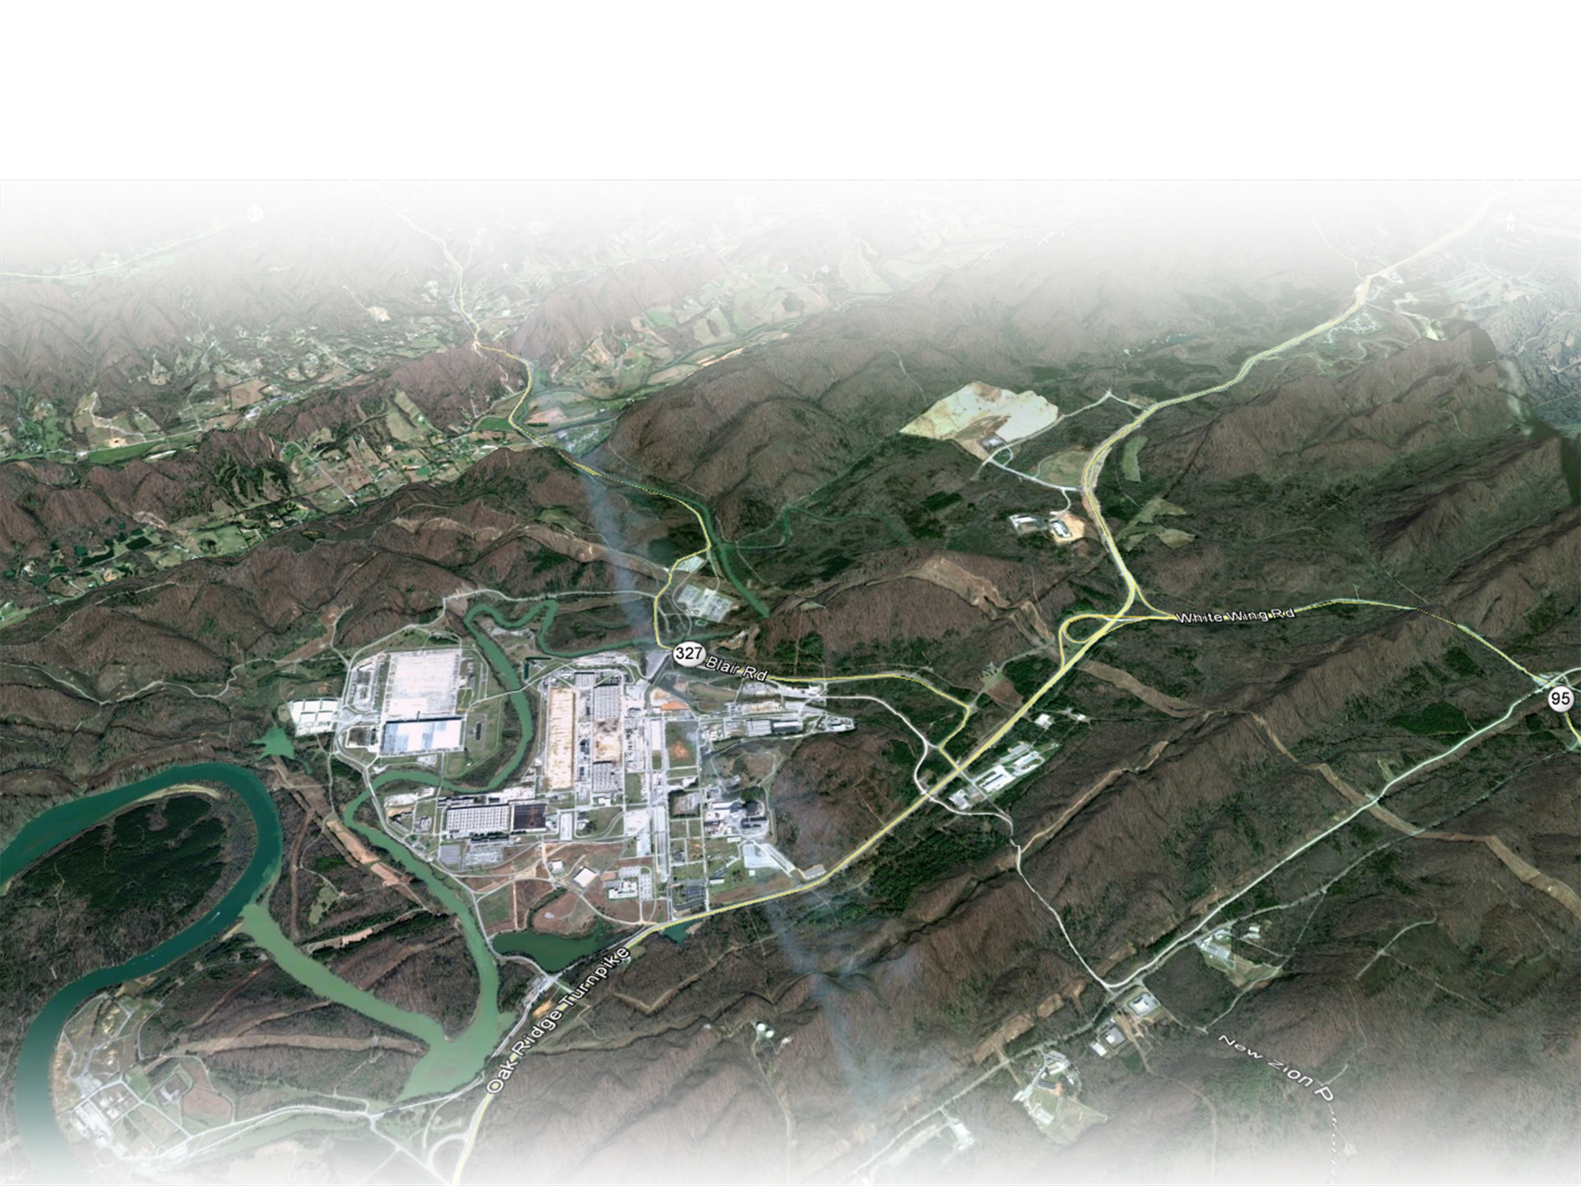

We evaluated 3 sites for a general aviation airport
Horizon Center site
Heritage Center site
ED-3 site
Notes:
Graphic Showing Three Site Locations. Describe each site.

Slide 6
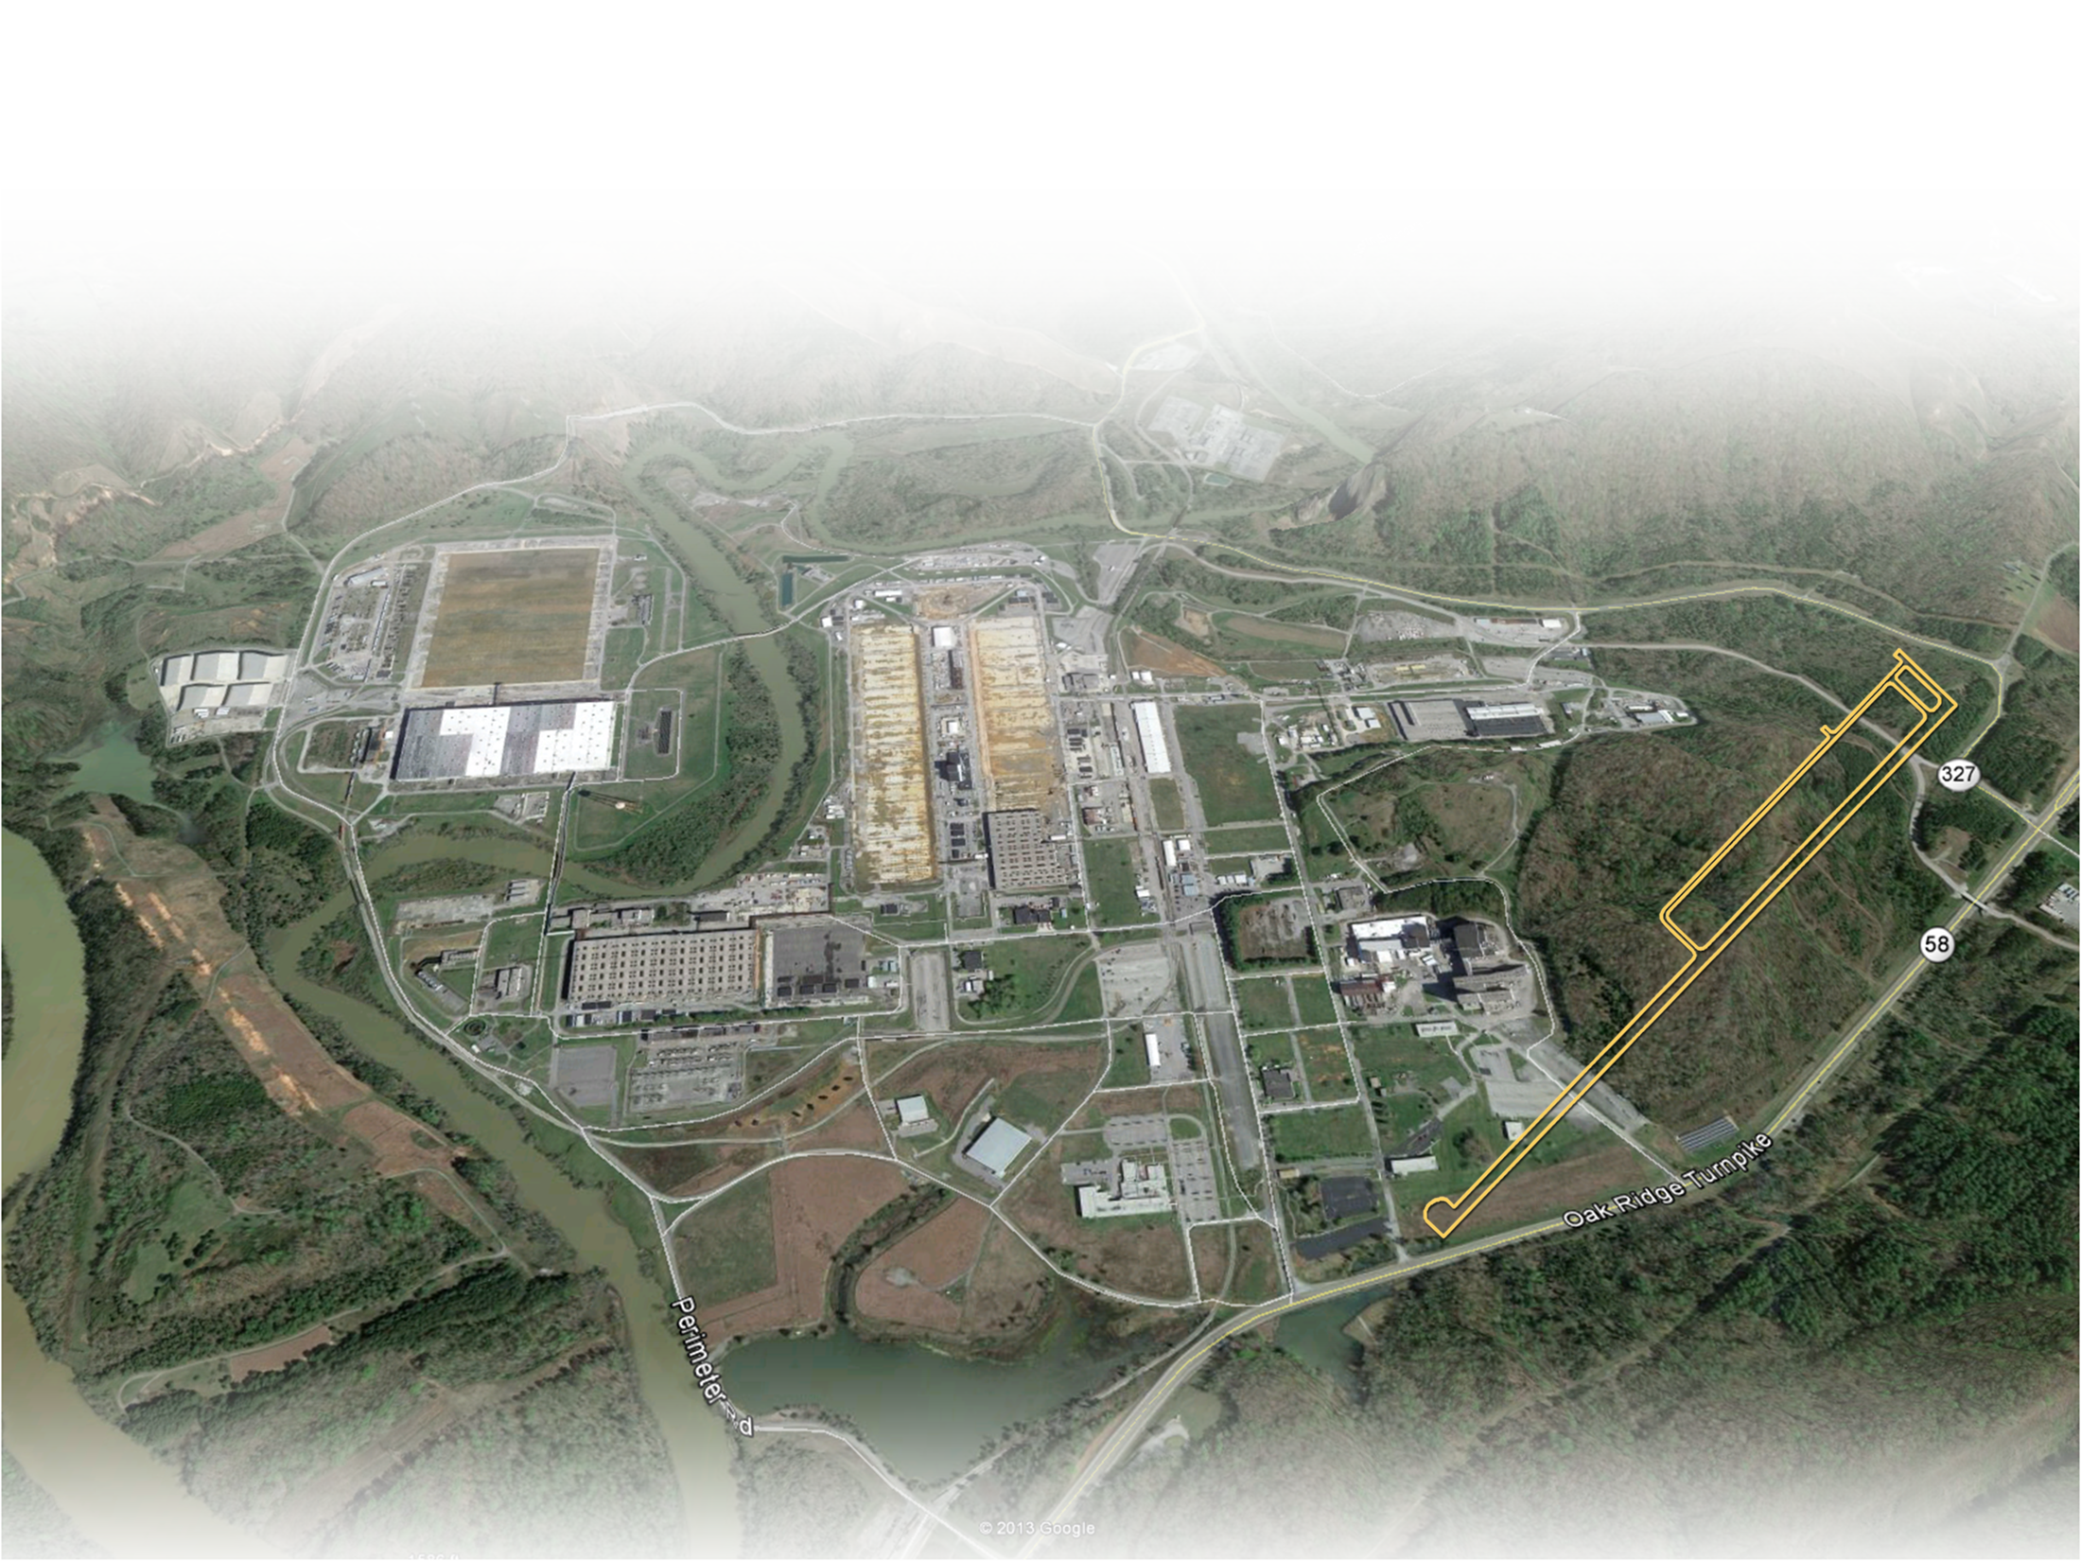
East Tennessee Technology Park (ETTP):
Best combination of land, cost and access
The recommended property is a designated
“brownfield” site
Notes:
Talk to graphic like this one. Speak about ‘will it work’ type evaluation.

Slide 7
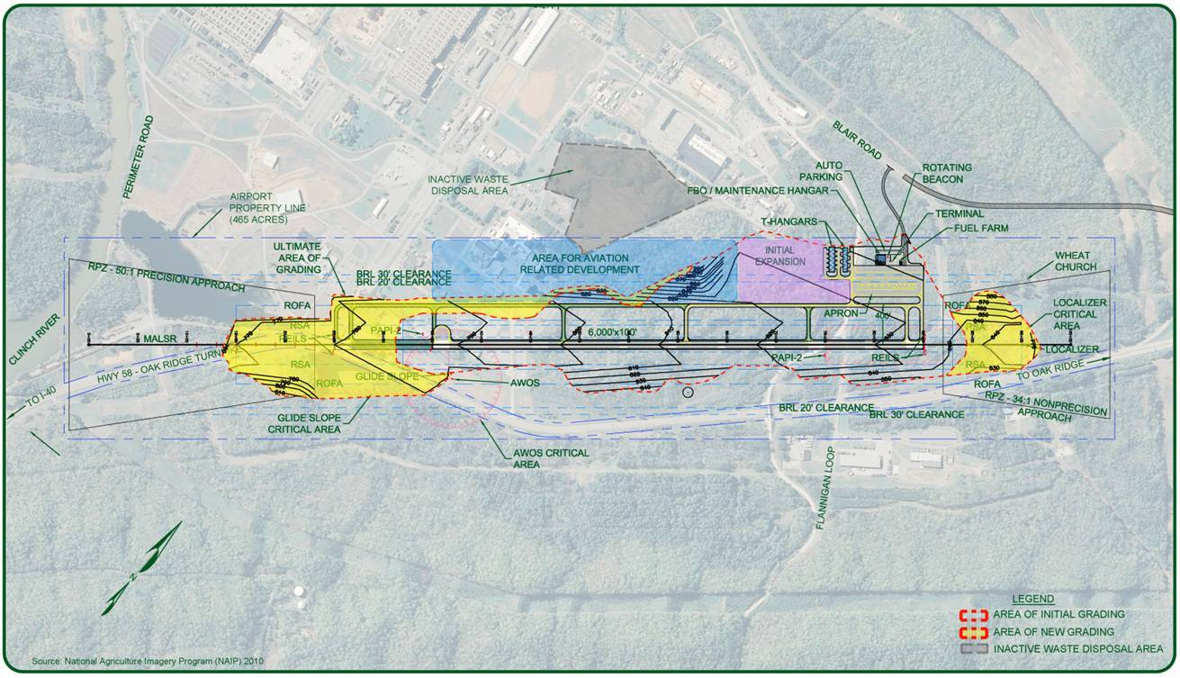
The project has passed
2 critical milestones

Slide 8


Milestone 1:
Justification Study submitted to FAA and Tennessee Aeronautics Commission
FAA: Inclusion in National Plan of Integrated Airport Systems (NPIAS)
The study accomplishes 2 goals
Inclusion qualifies the airport for federal
and state funding
State of Tennessee:
Inclusion in Tennessee
Airport System

Slide 9
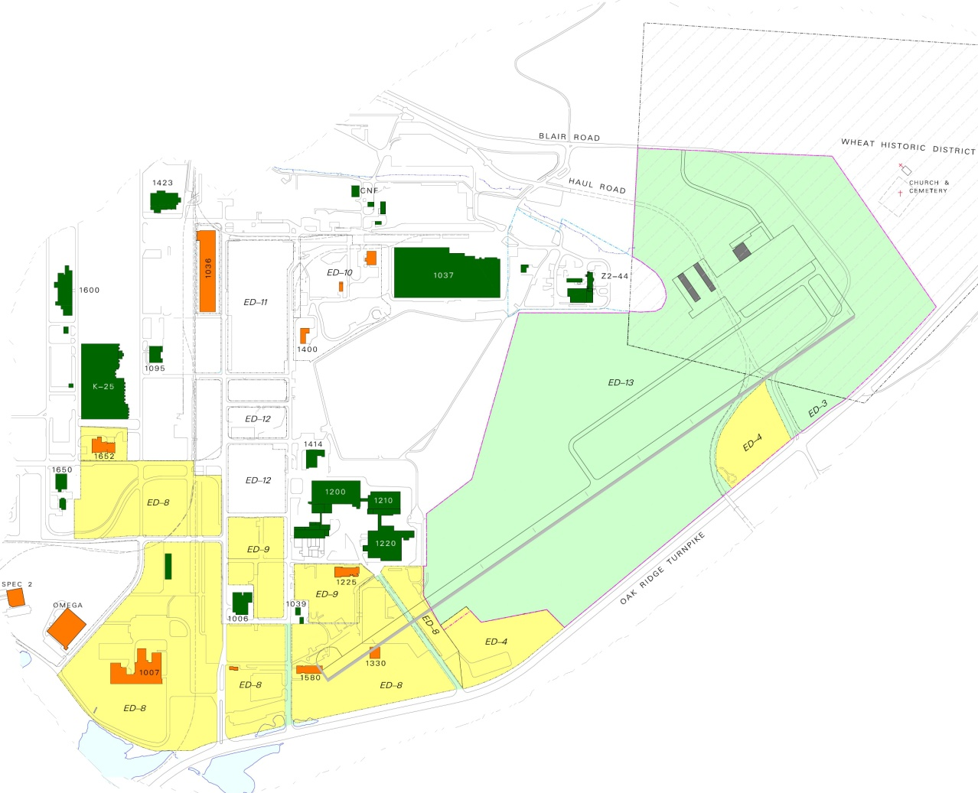
Milestone 2:
Land transfer application submitted to DOE
Transfer of 171 acres at ETTP will require:
  Archeological review by State Historical Commission
  NEPA evaluation
  by DOE/FAA
  Public hearing
Belongs to CROET
Yet to be transferred

Slide 10
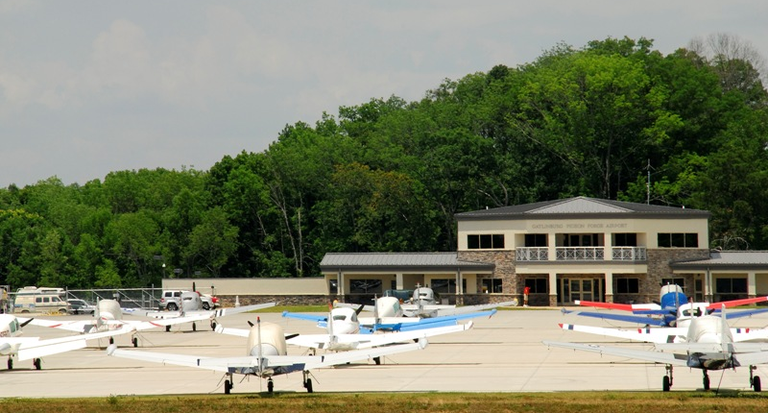
The airport will be owned and managed by MKAA
The airport will employ approximately 6–10 persons

Slide 11
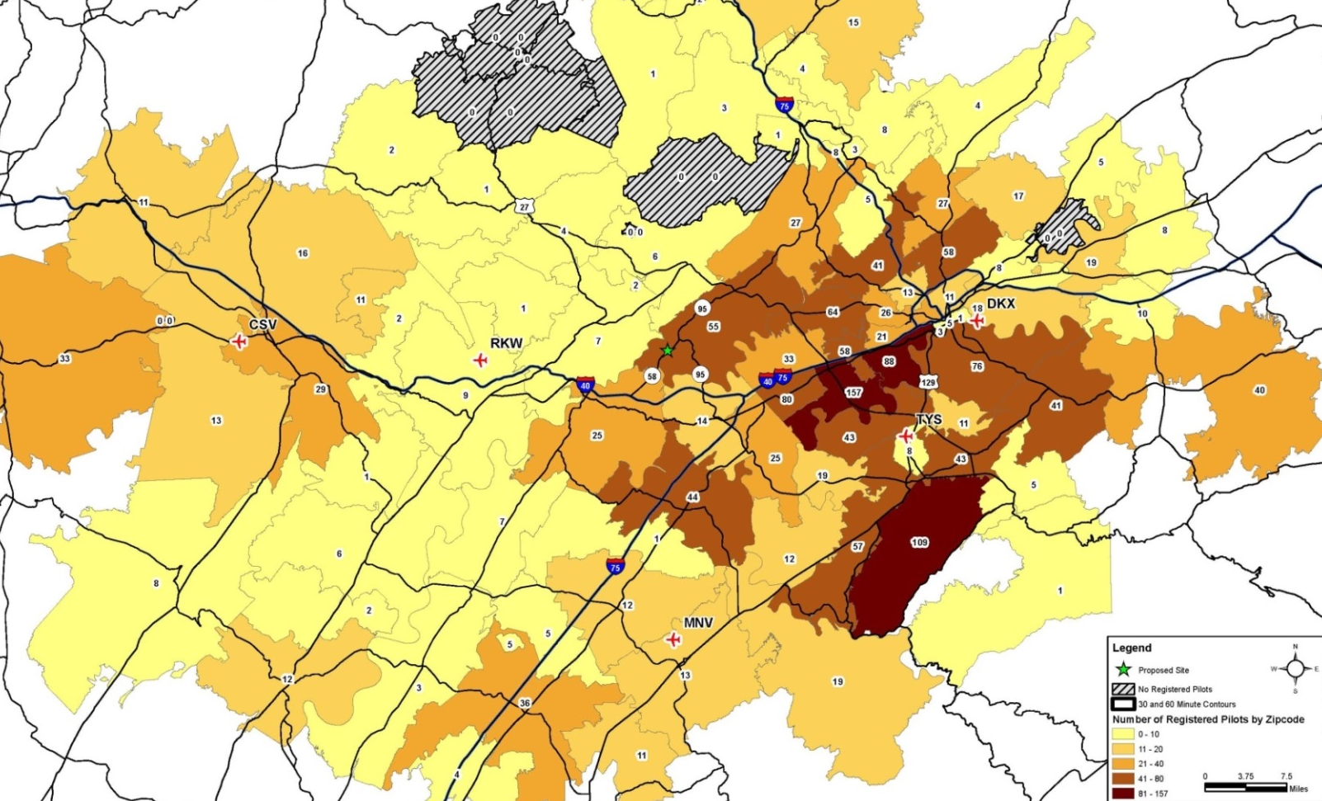

There are about 1,759 registered pilots in the Oak Ridge region

Slide 12
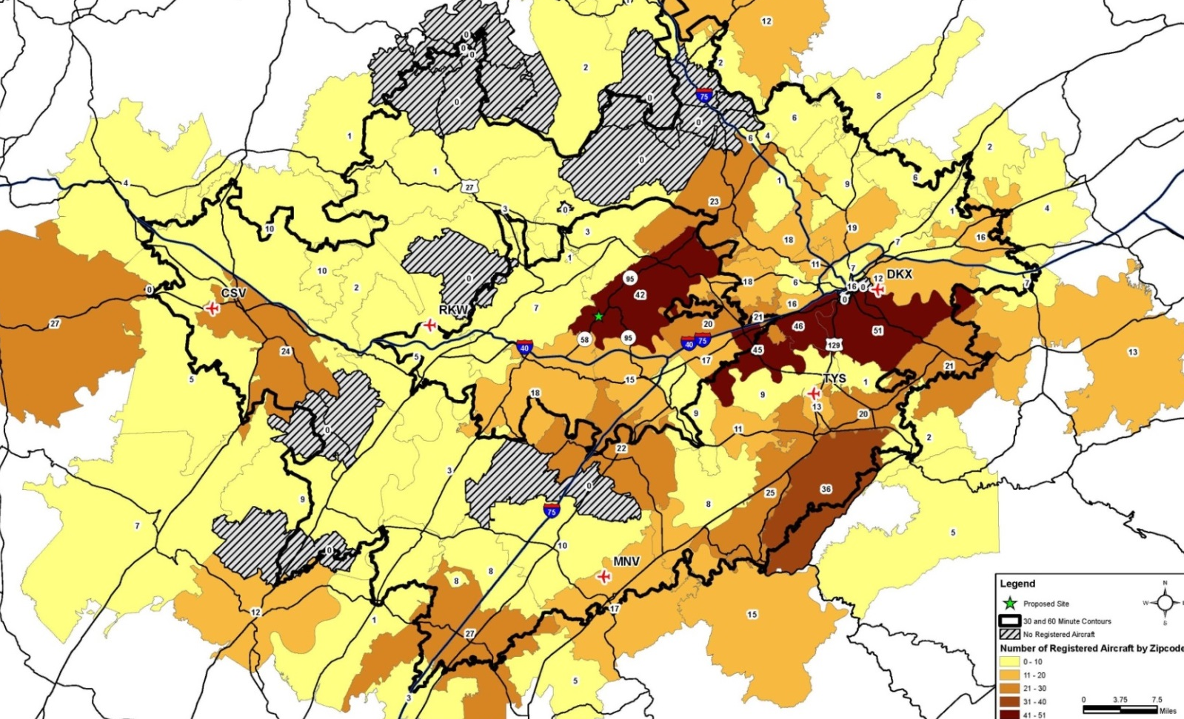
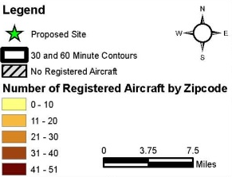
There are about 924 registered aircraft in the Oak Ridge region

Slide 13

Estimated cost of airport:
$35M−$45M
Funds are derived from aviation fuel taxes and user fees
Notes:
Results of the survey, included potential based aircraft identified.

Slide 14

The Oak Ridge airport will not be used for commercial traffic
The 5,000 ft runway will be limited to:
  Corporate planes located in Oak Ridge
  Private planes based in Oak Ridge
  Corporate and private planes
  doing business in Oak Ridge
  and surrounding areas
Oak Ridge
will not compete
with commercial
airline carriers

Slide 15

A general aviation airport does not produce unacceptable noise environment

Slide 16
The airport has 2 primary purposes
Leverage investments in economic infrastructure | Support for regional air service
Proximity to 2 industrial parks with rail, power, water, interstate access and city fire station Makes industrial parks attractive to businesses looking for sites Supports DOE “megaprojects” Small Modular Reactor Uranium Processing Facility | Our region is experiencing substantial population growth McGhee Tyson: Waiting list for corporate and private planes Downtown Island: Unable to accommodate many corporate planes

Slide 17

We are entering the project’s next phase
Preliminary planning study
Programming report
Justification
to FAA/Land transfer application
to DOE
Inclusion in NPIAS and Tennessee Airport System
Land transfer
to MKAA
Airport
master plan
Environmental permitting
Notes:
Mike Reiter will condense the bullets below.

Slide 18
Future steps anticipate construction in 2017–2018
Preliminary
design
Final
design
Site clearing
and demolition
Grading, drainage, and fencing construction
Reroute Blair & Haul Roads
Grand opening
Notes:
Mike Reiter will condense the bullets below.

